Slide 1
Different Types of Movement Physics in games
By James Marr

Slide 2
Introduction
Why this topic
Small select of coding types
The setup for the project
Diving into advantages and disadvantages
Any additional unique interactions
Overall insights

Slide 3
Why I choose this topic
How we interact with games
Its fun

Slide 4
Sections
Section 1: HardCoded
Section 2: ForcePhysics
Section 3: CodePhysics
Note: Section names are named
In a unorthodox way to keep track of

Slide 5

The Setup
Visual Studios 2022
C#
Unity 6000.041f1
Unity : Universal Core 2D

Slide 6
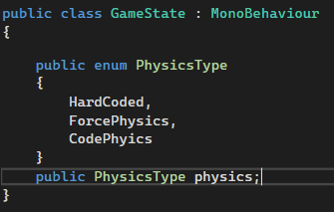
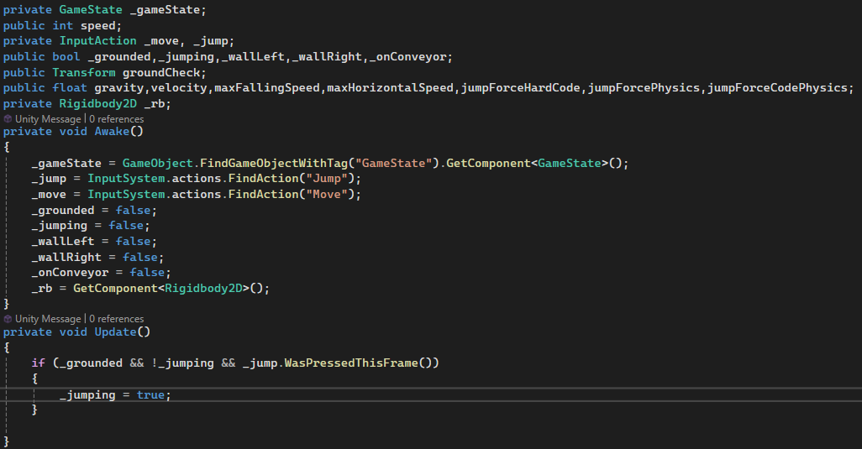

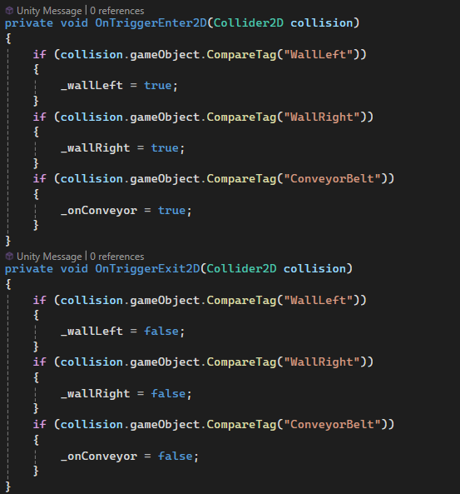
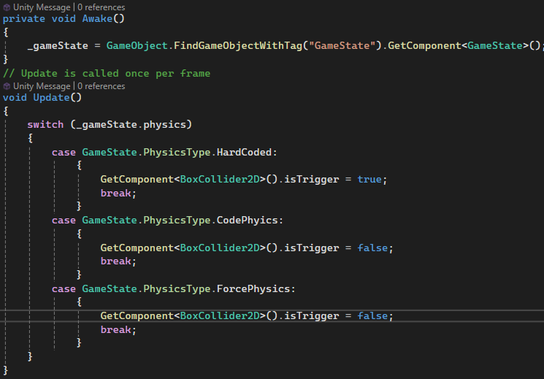
Other Details
Player Controller variables and methods
Game State
Universal FixedUpdate Code
Wall Code

Slide 7
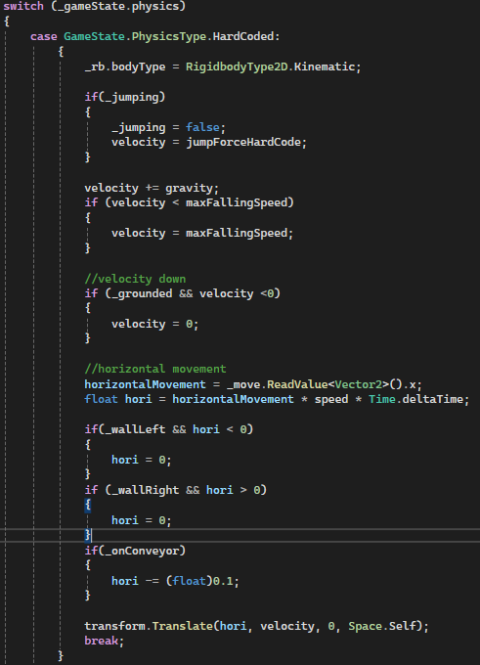
Section 1: HardCode

Slide 8
Advantages
Customizable Interactions
Unorthodox unique interactions

Slide 9
Disadvantages
Much More Code Needed
Must keep track of all interactions
Vary easy for objects to phase through each other
Potential inconsistencies

Slide 10
Unique Upsides
Can allow for movement through objects
More defined shifts in gravity

Slide 11
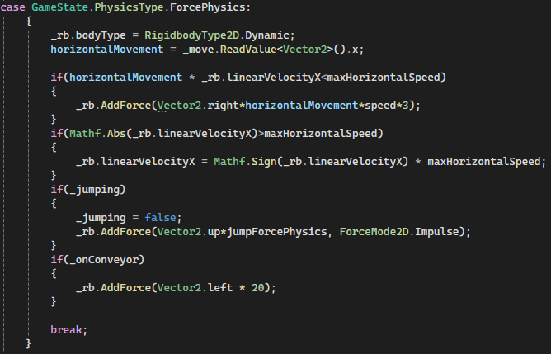
Section 2: ForcePhysics

Slide 12
Advantages
Built-in system = less time coding interactions
Able to lean on built in friction and mass variables
Scaled system to stack near limitless interactions

Slide 13
Disadvantages
Abstraction of not fully knowing the inner workings of code
The need of balancing objects mass, affected gravity and interactions

Slide 14
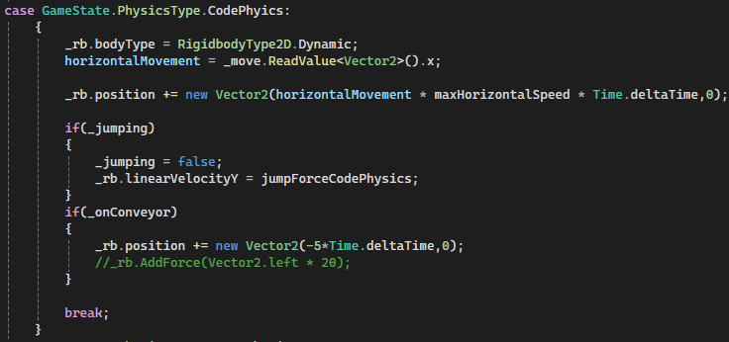
Section 3: CodePhysics

Slide 15
Advantages
Quantity of code needed is less comparatively
Control similar to Transform.Translate + still interacts with physics engine
Can decuple some interactions from physics for more precise control

Slide 16
Disadvantages
Unintended compounding effects
Still needs the environment to be setup

Slide 17
Unique Upsides
Multiple ways of interacting with the physics engine for different desired outcomes
Can decouple interactions that would need to be balanced across the whole system

Slide 18
Interesting overall insights
Each of the individual coding styles have advantages and disadvantages that developer can leverage
The unity engine has many robust systems that can help the developer not need to reimplement the wheel
Unity is also flexible enough to allow for custom built physics
Unity allows for not just 1 type of physics to operate on an object

Slide 19
Conclusion
Lean on built in physics engines
Don’t be afraid to test new ideas
Theres more than one way to move

Slide 20
References
Microsoft. (n.d.). Visual Studio. Retrieved from Visual Studio: https://visualstudio.microsoft.com/
Nintendo. (n.d.). Super Smash Bros. Retrieved from Super Smash Bros: https://www.smashbros.com/en_US/
Unity. (n.d.). Retrieved from Unity: https://unity.com/

